Slide 1
Client-Server Chat
Group 2

Slide 2
Contributions
Ziegfried Flameno – Base Classes,
Lance Lopez – Chat Server-Client
Kassandra Fuentes – UML Diagram, Register, Login
William Kalingasan – Database Transactions
Danna Soquiat – Chat Server-Client
Meynard Denoyo – Chat Server-Client

Slide 3
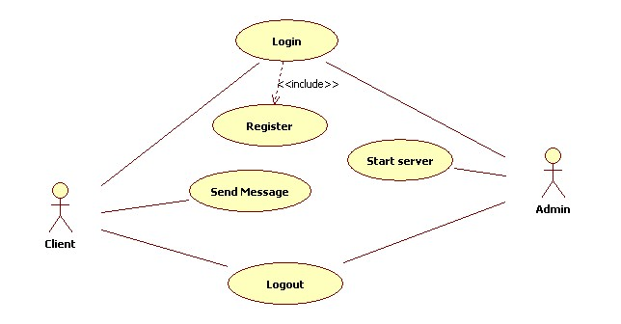
UML Diagram: Use case diagram

Slide 4
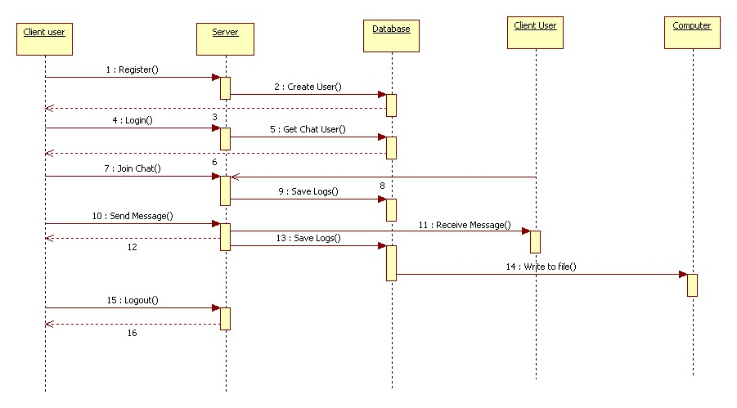
UML Diagram: System sequence diagram

Slide 5
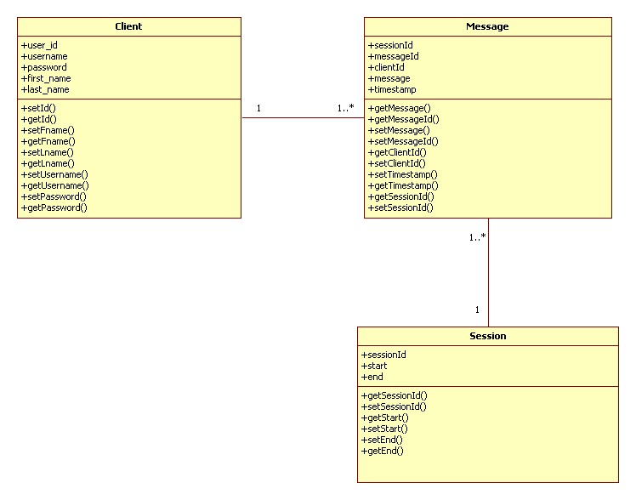
UML diagram: Class diagram

Slide 6
Program
Client may:
Register
Login
Login anonymously
After login:
Join chat
Wait for another client to chat with
Chat begins:
Send message
Receive message
Save logs to database
Save logs to file
View active
Logout
Bye command
‘Client B’ waits for another client

Slide 7
Classes
Transaction Classes
Register
Login
Chat
Chat Server
Chat Client
File Transaction
Database Transaction
Read Message
Send Message
Base Classes
Message
Session
Client
Default Page
Timestamp

